Slide 1
PROJECT 5
IMDB Movie Analysis

Slide 2
AGENDA:
Project Description
Tech Stack Used
Approach
Insights
Results and Conclusion

Slide 3
PROJECT DESCRIPTION
The dataset provided is related to IMDB Movies. A potential problem to investigate could be: "What factors influence the success of a movie on IMDB?" Here, success can be defined by high IMDB ratings. The impact of this problem is significant for movie producers, directors, and investors who want to understand what makes a movie successful to make informed decisions in their future projects.
The link to cleaned dataset with performed analysis is :-
https://docs.google.com/spreadsheets/d/1Q-J7jF8m05-j5zEp3IZtblL9GQH27QXw/edit?usp=drive_link&ouid=114522139830880122868&rtpof=true&sd=true

Slide 4
TECH STACK USED
Microsoft excel 365

Slide 5
APPROACH:
After going through the provided dataset we can observe that there are total 28 columns and 5043 rows.
Our approach for this project will be first cleaning the data, analysing the data and then visualizing the data according to the standard process.

Slide 6
DATA CLEANING AND PROCESSING
Firstly, we’ll reduce the column number by removing the unwanted columns which will not be required in any of our tasks. In the end we are left with 9 columns, they are director name, duration, gross, movie title, language, country, budget, imdb score. Then we removed the blank rows from the dataset. Lastly we removed the duplicate rows and now after cleaning the data we are left with 3786 rows and 9 columns.

Slide 7
TASK 1:
A. Movie Genre Analysis: Analyze the distribution of movie genres and their impact on the IMDB score.
Task: Determine the most common genres of movies in the dataset. Then, for each genre, calculate descriptive statistics (mean, median, mode, range, variance, standard deviation) of the IMDB scores.

Slide 8
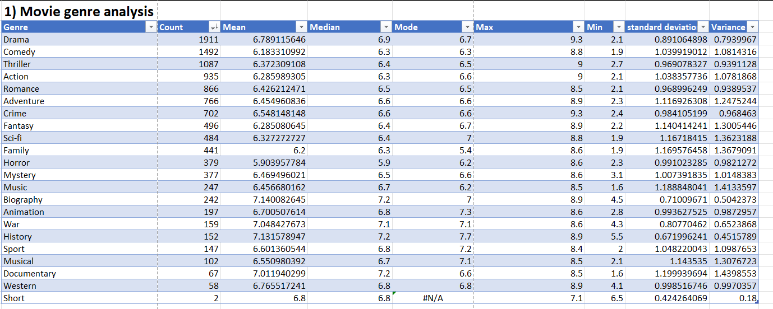

Slide 9
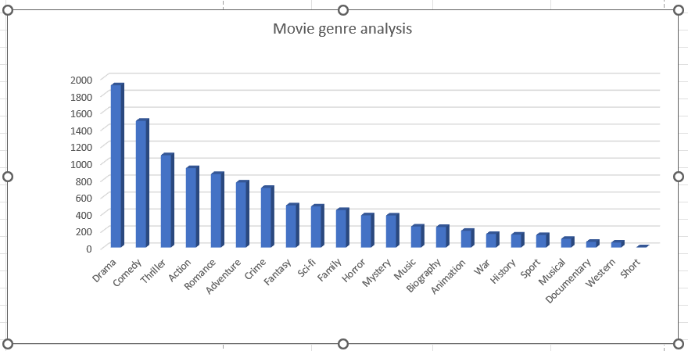
Result:- The top 5 movie genre on the basis of number of movies are drama, comedy, thriller, action and romance

Slide 10
INSIGHTS
Why is Drama the most common genre?
Drama tends to connect with a broad audience because it portrays characters and emotions in a realistic way, allowing viewers to relate to the stories on a personal level.
Why do realistic characters and emotions attract a broad audience?
Audiences are often drawn to stories that mirror real-life experiences and challenges. Drama frequently explores these themes, making it engaging by reflecting universal aspects of human life such as love, struggle, and personal growth.
Why do these universal themes increase the popularity of drama movies?
Themes that resonate with human experiences make drama adaptable across cultures and languages, allowing it to appeal to a global audience.
Why does having a wide audience make drama films more commonly produced?
Because drama appeals to many people, it often has a greater potential for box office success. This encourages studios and filmmakers to produce more drama movies to cater to this demand.
Why is this demand important in making drama the dominant genre?
High demand justifies continuous investment in the genre, leading to its consistent popularity and reinforcing its position as the most common genre due to both widespread appeal and profitability.

Slide 11
TASK 2
B. Movie Duration Analysis: Analyze the distribution of movie durations and its impact on the IMDB score.
Task: Analyze the distribution of movie durations and identify the relationship between movie duration and IMDB score.

Slide 12
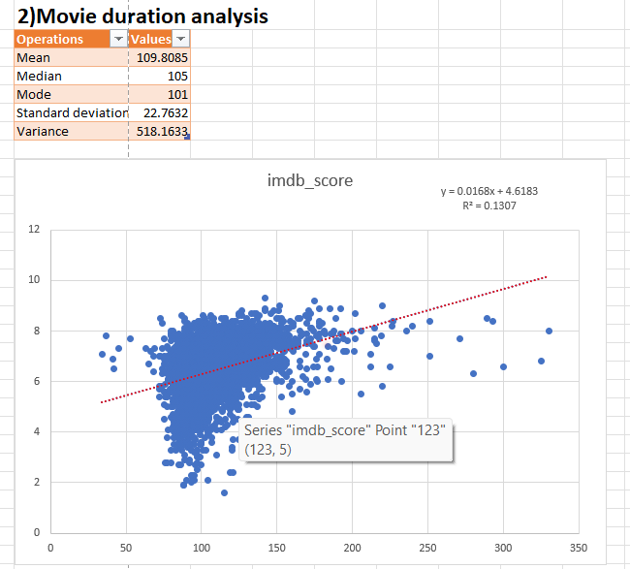
Result:- The Average duration of a Movie is 109 minutes. The trendline between the duration vs imdb score is elevated upward with R^2 = 0.1307. While duration isn’t the only factor, the extended time in longer movies often allows for more complex storytelling that viewers appreciate, which can lead to higher IMDb scores.

Slide 13
INSIGHTS
Why do longer movies tend to get higher IMDb scores?
Longer movies often have more time to develop characters and storylines, creating a more engaging experience for viewers.
Why does this added depth increase viewer engagement?
When viewers can connect with the characters and story on a deeper level, they feel more invested, which usually leads to better ratings.
Why does emotional investment lead to higher ratings?
Movies that hold viewers' attention and resonate emotionally are often rated more generously because people tend to overlook small flaws if they’re entertained.
Why are longer movies typically better at building this engagement?
With extra time, filmmakers can add complexity to the story, giving it layers that make the experience more memorable.
Why does this memorable experience boost IMDb scores?
Audiences reward movies that leave a lasting impression, so the richer storytelling that longer movies allow often translates into higher ratings.

Slide 14
TASK 3
C. Language Analysis: Situation: Examine the distribution of movies based on their language.
Task: Determine the most common languages used in movies and analyze their impact on the IMDB score using descriptive statistics.

Slide 15
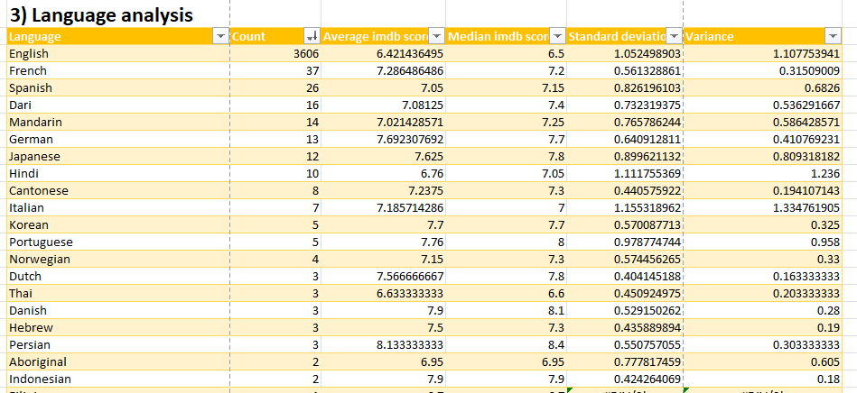
The Most common languages used in the movies are English, French, Spanish, Dari, Mandarin and German. I have also Observed that the languages Telugu and Persian have the highest average imdb score.

Slide 16
INSIGHTS
Why are some languages more common in movies?
Languages like English, French, and Spanish are popular because they reach large audiences globally, making films in these languages more impactful.
Why does reaching a larger audience matter?
Movies in widely understood languages can succeed internationally without heavy localization, so they’re more accessible to diverse viewers.
Why does accessibility affect IMDb scores?
When more people watch a movie, it gets a wide mix of ratings, often balancing out. High exposure can also mean more positive ratings if the film resonates globally.
Why do less common languages sometimes show higher IMDb scores?
Films in languages like Telugu and Persian may have smaller, more passionate audiences who connect culturally, often giving higher ratings.
Why is it useful to analyze IMDb scores by language?
Seeing language-based trends helps filmmakers understand audience appeal across regions, shaping strategies for both niche and global markets.

Slide 17
TASK 4
D. Director Analysis: Influence of directors on movie ratings.
Task: Identify the top directors based on their average IMDB score and analyze their contribution to the success of movies using percentile calculations.

Slide 18



Slide 19
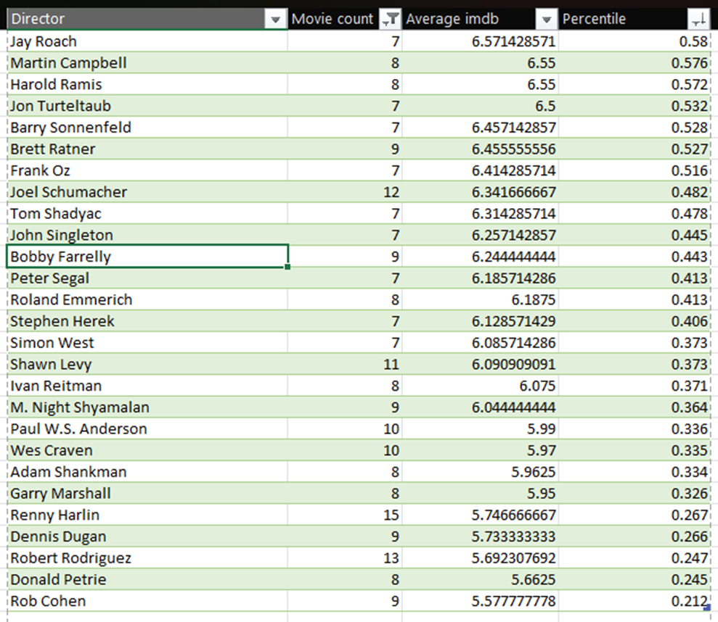
Result:-
Top 10 directors on the basis of imdb score are:-
Christopher Nolan
Quentin Tarantino
James Cameron
Peter Jackson
David Fincher
Martin Scorsese
Francis Ford Coppola
Wes Anderson
Paul Greengrass
Steven Spielberg
Note:- Here the conclusion derived is only based on the directors whose movie count is more than or equal to 7.

Slide 20
TASK 5
E. Budget Analysis: Explore the relationship between movie budgets and their financial success.
Task: Analyze the correlation between movie budgets and gross earnings, and identify the movies with the highest profit margin.

Slide 21
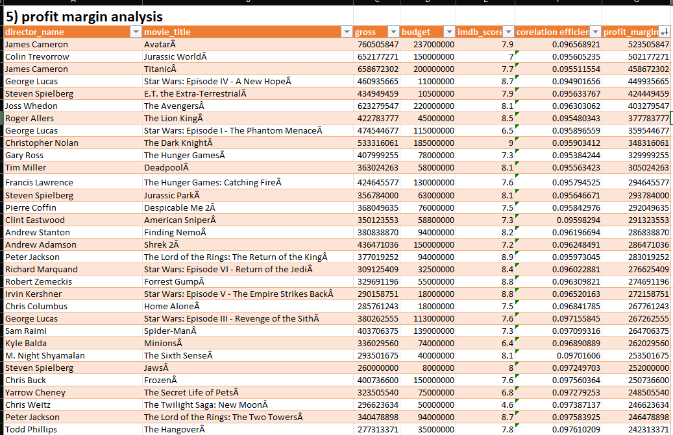

Slide 22
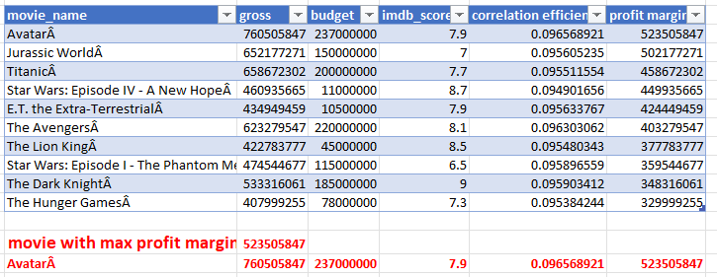
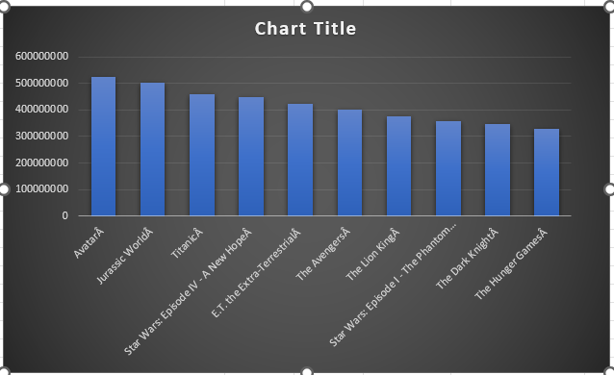
Result:-
The Top-5 movies with highest profits are Avatar, Jurassic World, Titanic, Star Wars: Episode IV
- A New Hope and E.T. The Extra-Terrestrial. The Correlation between budget and gross
is positive. larger budgets often lead to higher earnings and better profit margins, guiding studios in making profitable investment decisions.

Slide 23
INSIGHTS
Why do higher-budget movies tend to make more money?
Higher budgets allow for better production quality, star actors, and special effects, which can attract larger audiences.
Why does better quality and star power attract audiences?
Viewers are often drawn to high-quality visuals and well-known actors, as these elements increase entertainment value and excitement.
Why does attracting larger audiences result in higher earnings?
More viewers mean more ticket sales and revenue from other channels, increasing the movie's gross earnings.
Why do high earnings lead to greater profitability?
When a movie’s earnings far exceed its budget, the profit margin increases, making the film a financial success.
Why is understanding this relationship important for studios?
Knowing the link between budget and success helps studios plan investments wisely, aiming for profitability without unnecessary spending.

Slide 24
CONCLUSION
This project highlighted the importance of data analytics in movie analysis, offering valuable insights into factors like how directors, genres, and budgets relate to IMDb scores. Such insights are essential for making data-driven decisions in the film industry, helping stakeholders better understand what contributes to a movie’s success.
With the help of this project, I have gained valuable experience for data analysis using statistical knowledge and Excel’s data visualization. Through this, I have learnt to apply my data analysis skills in solving real life problems.

Slide 25

THANK YOU

